Slide 1
OWASP Top 10 Privacy Risks
Version 2.0 presented by Florian Stahl at
OWASP’s 20th Anniversary on 24 September 2021
https://owasp.org/www-project-top-10-privacy-risks/

Slide 2
Situation
Privacy
NSA & Co.
Global Use
Internet Techno-logies
GDPR
Schrems II
Violation of fundamental rights by surveillance because of excessive fear of terror – despite doubtful effectiveness
Lack of enforcement and insufficient control by authorities
Nutrition
Hobbies
Name
Friends
Salary
Phone number
Globalization requires global privacy standards
Login
IP-Address
Strong lobbyism
Location
License number
Opinions
Surveillance as business model –
Feudal internet
Lack of implementation and expert knowledge

Slide 3

Top 10 Privacy Risks Project – Facts & Figures
2014 Foundation & Publication of version 1.0
2015 Member of IPEN (Internet Privacy Engineering Network)
2016 Publication of countermeasures
2021 Publication of version 2.0
Currently working on countermeasures v2.0
Available in 5 languages (soon in 7)
OWASP Lab Project

Slide 4
Project Goal
Identify the 10 most important technical and organizational privacy risks for web applications
Provide transparency about privacy risks
Independent from “local” laws based on OECD Privacy Principles
Show countermeasures
Educate developers, business architects and legal
Not in scope: Self-protection for users
Limitation of Collection
Data Quality
Specification of the Purpose
Use Limitation
Security
Transparency
Individual Participation
Accountability

Slide 5
Method (1/2)
Model Creation
OECD Privacy Principles
Identifying Violations
Rating of Violation Impact
Investigation of Frequency of Occurence
Rated List of Privacy Risks
Evolve Counter-Measures
Evolve Best Practices

Slide 6
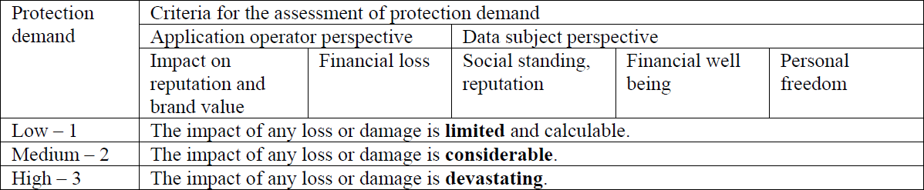
Method (2/2)
Survey to evaluate frequency of occurrence
60 privacy and security experts participated (62 in 2014)
Rated 20 privacy violations for their frequency in web sites
Slider instead of 4 radio buttons unexpectedly caused less differences
Impact rating

Slide 7
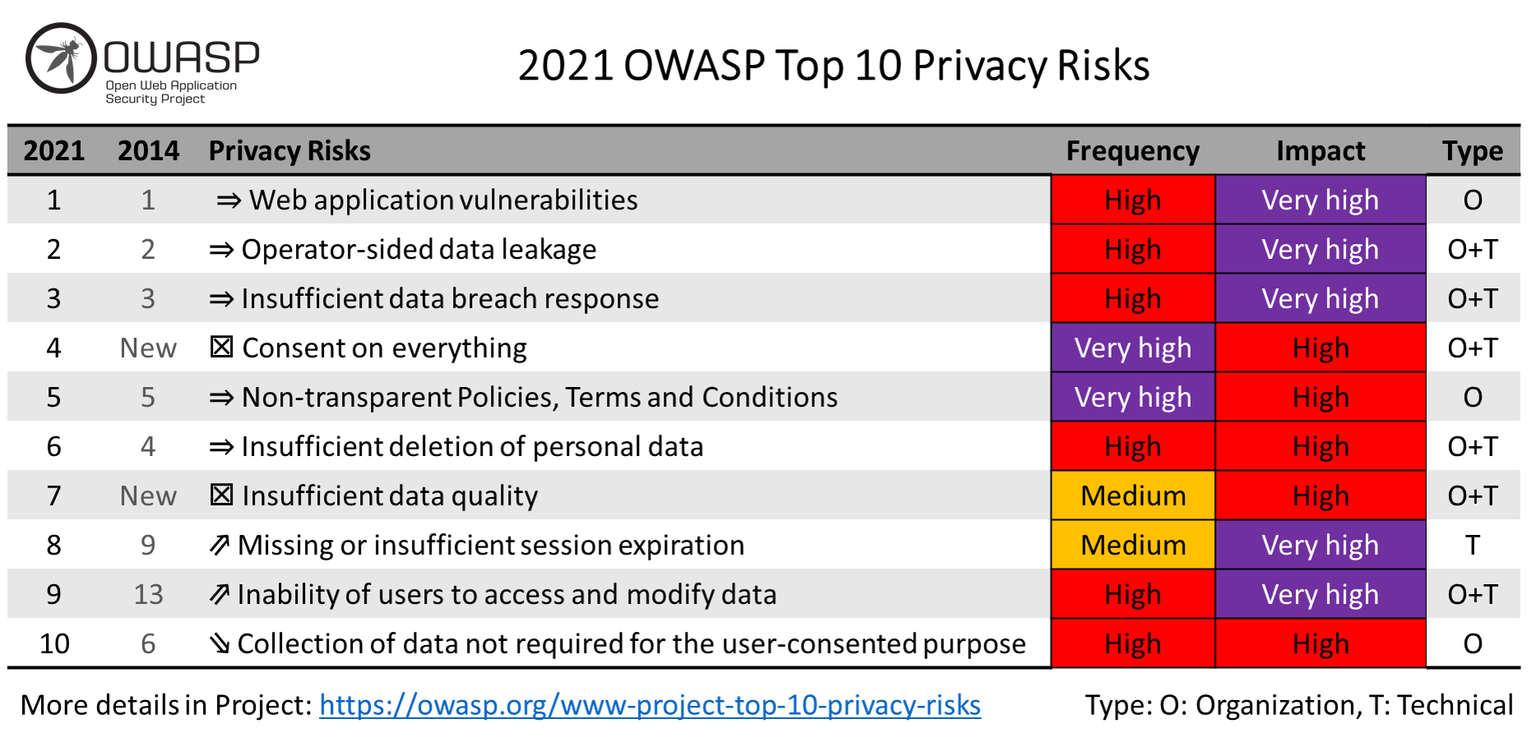

Results Overview
T
Type O: Organizational, T: Technical

Slide 8

P1: Web Application Vulnerabilities
How to check?
Are regular penetration tests performed (OWASP Top 10)?
Are developers trained regarding web application security?
Are secure coding guidelines applied?
Is any of the used software out of date (server, DB, libs)?
How to boost?
Apply procedures like the Security Development Lifecycle
Perform regular penetration tests by independent experts
Install updates, patches and hotfixes on a regular basis

Slide 9

P2: Operator-sided Data Leakage
How to check?
Research the reputation and reliability of the operator
Audit the operator (before signing the contract or using it):
Paper-based audit (fair)
Interview-based audit (good)
On-site audit and system-checks (best)
How to boost?
Implement Awareness Campaigns
Encrypt personal data
Appropriate Identity & Access Management
Strong Anonymization or Pseudonymization
Further measures to prevent leakage of personal data (ISO 2700x)

Slide 10

P3: Insufficient Data Breach Response
How to check?
Incident response plan in place?
Plan tested regularly (request evidence like a test protocol)?
Computer Emergency Response Team (CERT) / Privacy Team in place?
Monitoring for incidents (e.g. SIEM) in place?
How to boost?
Create, maintain & test an incident response plan
Continuously monitor for personal data leakage and loss
Respond appropriately to a breach
Assign incident manager and incident response team
Notify data owners
…

Slide 11
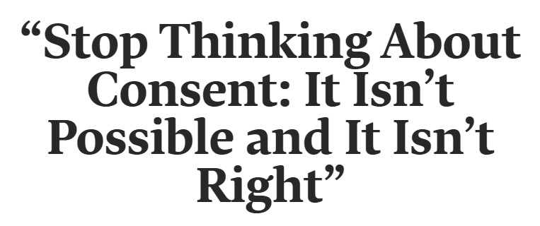
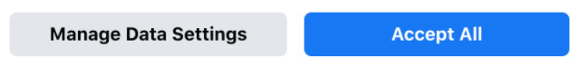
P4: Consent on Everything *New*
How to check?
Is consent aggregated or inappropriately used to legitimate processing?
Data flow restrictions rather than consent
How to boost?
Collect consent separately for each purpose (e.g. use of website and profiling for advertising).
Consent should be voluntarily
Helen Nissenbaum on Post-Consent Privacy - YouTube
Picture sources: Why Data Privacy Based on Consent Is Impossible (hbr.org)
& www.facebook.com

Slide 12
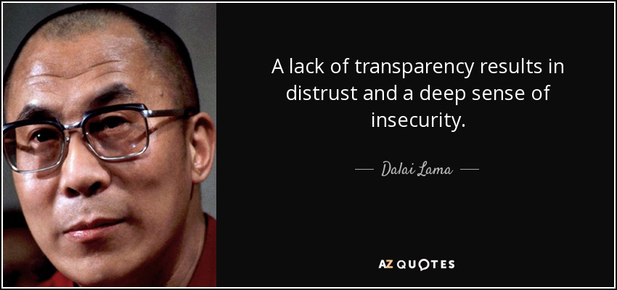
P5: Non-transparent Policies, Terms & Conditions
How to check?
Check if policies, terms and conditions:
Are easy to find and understandable for non-lawyers
Fully describe data processing
Which data are collected, for what purpose, …
In your language
Complete, but KISS (Keep it short and simple)
How to boost?
Use a text analyzer, e.g.: https://readable.com/
A short version of the T&Cs and pictograms can be used for easier understanding
Use release notes to identify change history of T&Cs and policies/notices over time
Deploy Do Not Track (W3C standard) and provide Opt-out

Slide 13
P6: Insufficient Deletion of Personal Data
How to check?
Inspect the data retention or deletion policies / agreements.
Evaluate their appropriateness
Request deletion protocols
Test processes for deletion requests
How to boost?
Delete personal data after termination of specified purpose
Delete data on rightful user request
Consider copies, backups and third parties
Delete user profiles after longer period of inactivity

Slide 14
P7: Insufficient Data Quality *New*
How to check?
Is it ensured that personal data is up-to-date and correct
Check for possibilities to update personal data in the application
Regular checks for validation, e.g. “Please verify your shipping address”
Question how long it is likely that data is up to date and how often it usually changes
How to boost?
Provide an update form
Ask user if his/her data is still correct
Forward updated data to third parties / subsystems that received the user’s data before

Slide 15
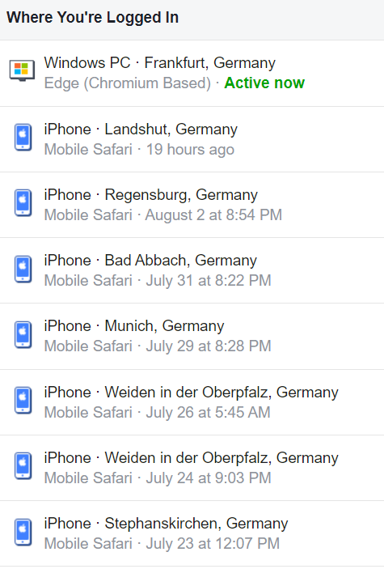
P8: Missing or Insufficient Session Expiration
How to check?
Is there an automatic session timeout < 1 week (for critical applications < 1 day).
Is the logout button easy to find and promoted?
How to boost?
Configure to automatically logout after X hours / days or user-defined
Obvious logout button
Educate users
Picture source: facebook.com

Slide 16
P9: Inability of users to access and modify data
How to check?
Do users have the ability to access, change or delete data related to them
Are access, change or deletion requests processed timely and completely
How to boost?
Provide easy-to-use ways to access, change or delete data
Appropriate Data Structure Model to handle user rights

Slide 17
P10: Collection of data not required for the user-consented purpose
How to check?
Request description of purpose
Check if collected data is required to fulfill the purpose
If data is collected that is not required for the primary purpose(s), check if consent to collect and process this data was given and is documented
Are individuals notified and asked if purpose or processing is changed?
How to boost?
Define purpose of the collection at the time of collection and only collect personal data required to fulfill this purpose
Data minimization
Option to provide additional data voluntarily to improve service (e.g. product recommendation, personal advertisement)

Slide 18
Challenges in creating version 2.0
Time, time, time …
Work on version 2.0 began in the beginning of 2020 and was done more than one year later
Coordinate a (new) virtual team of people with different background from all over the world
Few conference calls
Work in Google Docs
You need someone with the big picture and the goal in mind
It was harder to find volunteers than in 2014 – privacy experts seem to be busier
Overlaps between risks (e.g. P7 and P9) and abstraction level

Slide 19

Next steps
Translations (Chinese)
Countermeasures v2.0
Spread the word
Apply in practice ;-)

